Slide 1
Code Generation aim 2023 Josh Bergman

Slide 2
Who Am I?
Notes:
Qmlativ
Ed-Fi
Volt (WI, MI, FL)
Oxblood
Tool Creation -- Today

Slide 3
Code Generation Methods
DEVELOPER TOOL
NUGET LIBRARY
DESIGN-TIME
Notes:
Today I want to look at 3 different ways we currently use code generation
Mostly the same technically

Slide 4
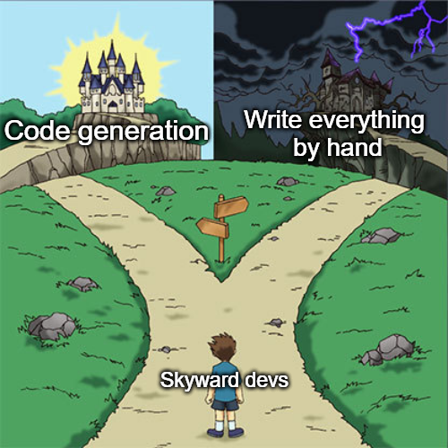
Code Generation Methods
DEVELOPER TOOL
NUGET LIBRARY
DESIGN-TIME
Notes:
This session might give the impression that I’m advocating Code Generation, however

Slide 5
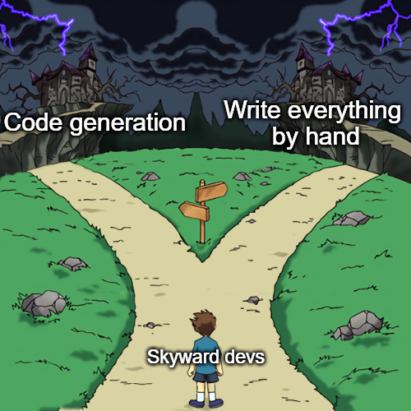
Code Generation Methods
DEVELOPER TOOL
NUGET LIBRARY
DESIGN-TIME
Notes:
The reality is: often code generation is a bandage for things which are not supported well enough in framework.
It’s common that common State-reporting tasks are not well-supported in framework and thus require large amounts of boiler plate code.
SkywardID guids are a large cause of not being able to create good framework methods (there’s ways around this)

Slide 6
Code Generation Methods
Before using code generation:
FRAMEWORK Common tasks should not require large amounts of boilerplate
HELPER METHODS Common tasks should share a common method if we’re going to update them all should something change (ie standards change)
DEVELOPER TOOL
NUGET LIBRARY
DESIGN-TIME
Notes:
If you can do a task without code generation, this is preferable.
One route often ignored (for good and bad reasons) is adding better framework support
Helper methods can be an answer, but often aren’t enough to fully avoid generation. Just make sure that we aren’t generating the same method 100x that we then need to update 100x

Slide 7
Developer Tool Code Generation Provide a visual studio extension to allow devs to generate files
Pros:
Cons:
Allows devs to modify after generation
Allows more intuitive interface
Can generate multiple files in multiple projects
More setup work to use
Requires knowing VS extensions*
Tool maintenance ownership

Slide 8
Library Code Generation Separate executable that generates code to be compiled and released as a NuGet package imported back into Qmlativ
Pros:
Cons:
Complete classes created
Better ownership (whoever needs the update)
No knowledge of outside frameworks
Limited use cases
Can’t create Qmlativ classes (DataObjects or Loaders)
Separate codebases from Q
Tool maintenance

Slide 9
design-time Code Generation Generate code just before Build to be compiled in normal Qmlativ builds
Pros:
Cons:
Complete classes created
No separate codebases
No knowledge of outside frameworks
T4 syntax is ugly
Intimidating maintenance
Generating multiple files poorly supported
Hard to debug, no autocomplete

Slide 10
Code Generation Methods
All methods look about the same code-wise
No time for VS Extensions and I don’t know them well
Will show a CLI-based generator and design-time generator

Slide 11
T4 Templates (.tt)
Basis of all methods discussed
Sometimes more painful than just using StringBuilder
I honestly don’t like using them
Despite this, I will still show how they work

Slide 12
T4 Templates (.tt)
Runtime Text Template | Text Template (Design-time)
You create T4 Template (MyTemplate.tt)
T4 creates backing transform class (MyTemplate)
MyTemplate is saved to MyTemplate.cs | MyTemplate is compiled by T4
 | T4 executes MyTemplate.TransformText() to create MyClass
 | T4 saves MyClass to MyTemplate.cs
Your code uses MyTemplate | Your code uses MyClass
Your code executes MyTemplate.TransformText() to create MyClass
Your code saves MyClass to MyClass.cs
Run Custom Tool

Slide 13
Code Time

Slide 14
Examples
Q State Reporting (extension) VS extension with code generator utility https://github.com/skywardinc/Qmlativ_StateReporting
Skyward.EdFiResources Library generated from Swagger docs (JSON data) https://github.com/skywardinc/EdFiSwaggerDLLGenerator
DOEFileParser.tt Qmlativ design-time generator (creates file parsing classes) ~/Business/StateReportingFL/DOEFileImport/DOEFileParser.tt

Slide 15
Questions?
Slides & Code: https://github.com/7thFox/AIM2023-CodeGeneration

